Slide 1
What is TypeScript?
TypeScript is a superset of JavaScript that is compiled to JS, and has benefits like type safety. It helps catch errors during development.
Why use TypeScript?
Detects bugs at compile-time, not runtime.
Adds IDE auto-completion & better readability.
Supports OOP (Classes, Interfaces, etc.).

Slide 2
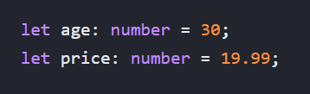


Basic Types
Just like in JavaScript, Typescript has primitive data types and non-primitive data types.
Primitive Types:
number: represents both integer and floating-point numbers.
string: represents textual data, enclosed in single quotes, double quotes, or backticks (for template literals).
boolean: represents a logical value, either true or false.
null: represents the intentional absence of any object value.
undefined: represents a variable that has been declared but not yet assigned a value, or a property that doesn't exist.
symbol: represents a unique, immutable value, often used as object keys.
bigint (ES2020+): represents integers with arbitrary precision, larger than what number can safely represent.

Slide 3




Basic Types
Primitive Types:
null: represents the intentional absence of any object value.
undefined: represents a variable that has been declared but not yet assigned a value, or a property that doesn't exist.
symbol: represents a unique, immutable value, often used as object keys.
bigint (ES2020+): represents integers with arbitrary precision, larger than what number can safely represent.

Slide 4
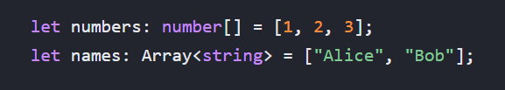

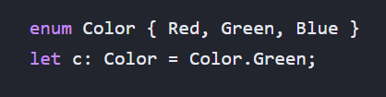

Basic Types
Object Types:
Array: represents a collection of elements of the same type.
Tuple: represents an array with a fixed number of elements whose types are known at specific positions.
enum: provides a way to define a set of named constant values.
any: represents any type, effectively opting out of type-checking for a variable. Use with caution.
See Labs for code demo

Slide 5
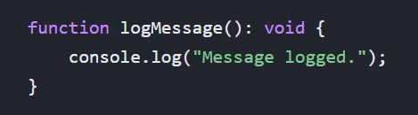
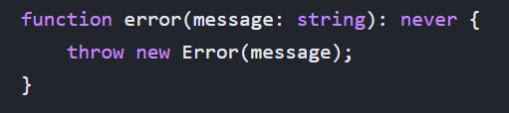
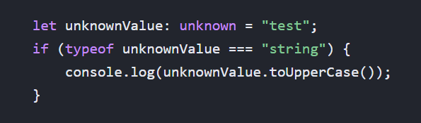

Basic Types
Object Types:
void: represents the absence of any type, typically used as the return type for functions that do not return a value.
never: represents the type of values that never occur, often used as the return type for functions that always throw an error or never return.
unknown: similar to any, but safer. You cannot perform operations on an unknown type without first narrowing it to a more specific type.
Object: represents any non-primitive type. While available, using more specific types like interfaces or classes is generally preferred.
See Labs for code demo

Slide 6
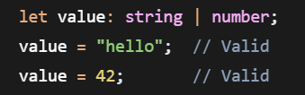
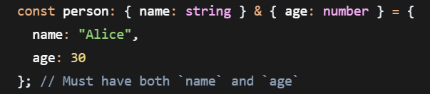
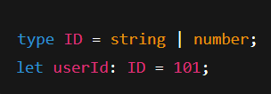
Type Aliases, Union Types, Intersection Types
Union types: a union type allows a value to be one of several types. Use | to combine types.
Intersection types: an intersection type combines multiple types into one, requiring the value to satisfy all constituent types. Use & to merge types.
Type aliases: type aliases allow you to create custom names for existing types. They're defined using the type keyword.
See Labs for code demo

Slide 7
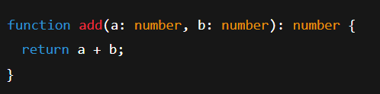
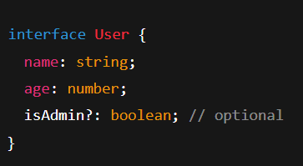
Functions Typing and Interfaces
Function typing: you can define types for parameters and return values.
Interfaces: interfaces define the structure (shape) of objects.
See Labs for code demo

Slide 8
Classes and OOP Concepts
TypeScript enhances JavaScript classes with type annotations and access modifiers.
There are three main visibility modifiers in TypeScript:
public: (default) allows access to the class member from anywhere.
private: only allows access to the class member from within the class.
protected: allows access to the class member from itself and any classes that inherit it.
Keywords that support OOP concepts:
Extend: Classes can extend each other through the extends keyword. A class can only extend one other class.
Implement: Interfaces can be used to define the type a class must follow through the implements keyword.
Override: Classes can override a base class method through the override keyword.
See Labs for code demo

Slide 9
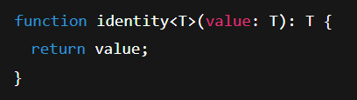
Generics
Generics allows developers to create reusable components that can work with a variety of data types while maintaining type safety
Generics can be implemented with functions, interfaces, etc.
See Labs for code demo

Slide 10
Modules
A module is just a file that contains reusable code like variables, functions, or classes, and can be imported or exported to other files.
There are two module systems in JavaScript:
CommonJS (CJS): used in older versions of Node.js (<13). File extension are .js or .cjs
ES Modules (ESM): Used in Modern JS (browser & Node >= v13). File extension are .mjs or "type": "module" in package.json
See Labs for code demo

